Slide 1
Quiz Last Week

Slide 2
Assignment Last Week

Slide 3
Lecture 7
Trees

Slide 4
Binary Tree
A data structure made up of nodes that are arranged in a hierarchical manner
Can hold key/value pairs like a hash table
Unlike a list, a node can have two successors

Slide 5
Binary Tree
Leaf: a tree node with no children
Internal node: a tree node with at least one child
Parent: the term for the internal node that the current leaf stems from
Root: the one tree node with no parent

Slide 6
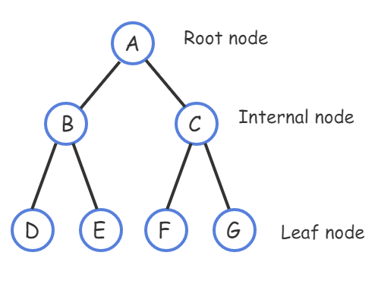
Binary Tree

Slide 7
Binary Tree
The link from a parent to a child is called an “edge”
A node’s depth is the number of edges on the path from the root to the node
The root node thus has depth 0
All nodes with the same depth form a tree level
A tree’s height is the largest depth of any node
A tree with just one node has height 0

Slide 8
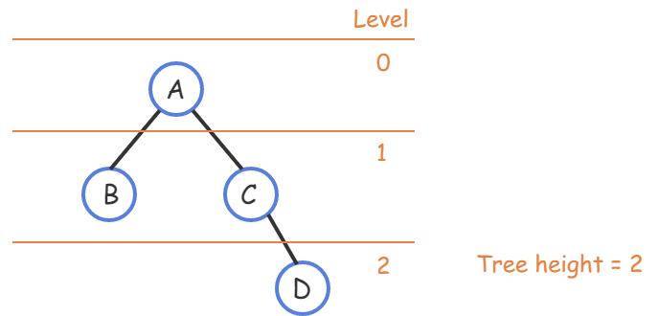
Binary Tree

Slide 9
Binary Search Trees
A tree that has an ordering property to enable fast searching
Nodes in the left subtree have a key less than the current node
Nodes in the right subtree have a key greater than the current node
Makes Binary Trees more efficient

Slide 10
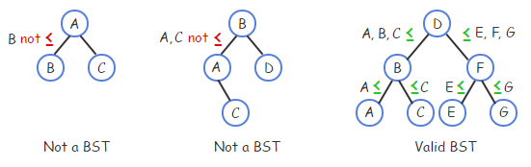
Binary Search Tree

Slide 11
Searching a BST
To search nodes means to find a node with a desired key, if it exists
A Binary Search Tree may be faster than a traditional list when searching
Starts at the root node
If a child to be visited doesn’t exist, the node you are searching for must not be in the Tree
Only a small fraction of nodes need to be checked

Slide 12
Searching a BST
Searching a BST in the worst case requires h + 1 comparisons
Where h is the tree height
A tree with a root node and one child has height 1
The worst case visits the root and the child
A major BST benefit is that an n-node tree’s height may be as small as O(log n), yielding extremely fast searches

Slide 13
Searching a BST
Searching a 10,000 node BST may require only 14 comparisons
A binary tree’s height can be minimized by keeping all levels full, except possibly the last level
An “all-but-last-level-full” binary tree’s height is h = log(n)

Slide 14
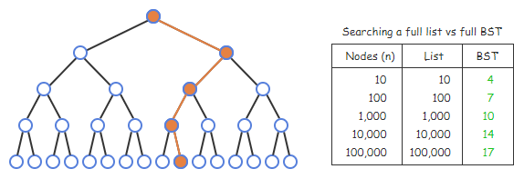
Searching a BST

Slide 15
BST Searching
A simple BST search algorithm checks the current node (initially the tree’s root)
If that node is not a match, then move to the left or right child depending on whether the key is less or greater
Repeats until the desired node is found or returns 0 if not found

Slide 16
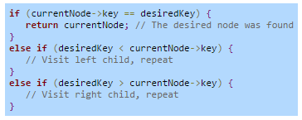
Searching a BST

Slide 17
BST Ordering
A BST defines an ordering among nodes, from smallest to largest
A node’s successor is the node that comes after in the BST ordering
A node’s predecessor is the node that comes before in the BST ordering

Slide 18
BST Ordering
If a node has a right subtree, the node’s successor is that right subtree’s leftmost child
If a node doesn’t have a right subtree, the node’s successor is the first ancestor having this node in a left subtree

Slide 19
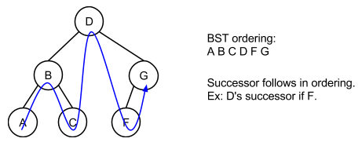
BST Ordering

Slide 20
BST Insert Algorithm
A simple BST insert algorithm compares the new node with the current node (initially the root)
If the new node’s key is less than the current node, and the current node’s left child is 0, insert as left child
If the new node’s key is greater than the current node, and the current node’s right child is 0, insert as right child
If the node’s child is not 0, the algorithm assigns the current node with that child and continues

Slide 21
BST Remove Algorithm
A BST remove operation removes the first-found matching node
The tree must be restructured to preserve the BST ordering property
The algorithm first searches for a matching node just like the search algorithm
If found, the algorithm performs one of multiple actions

Slide 22
Removal Actions
Remove a leaf node
The parent's left or right child (whichever points to X) is assigned with 0. Else, if X was the root, the root pointer is assigned with 0, and the BST is now empty. Remove an internal node with single child
Remove an internal node with single child
The parent's left or right child (whichever points to X) is assigned with X's single child. Else, if X was the root, the root pointer is assigned with X's single child.
Remove an internal node with two children
This case is the hardest. First, the algorithm locates X's successor (the leftmost child of X's right subtree), and copies the successor to X. Then, the algorithm recursively removes the successor from the right subtree.

Slide 23
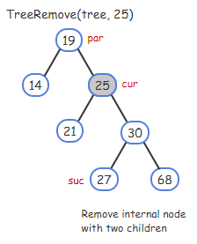
Internal Node Removal: Step 1

Slide 24
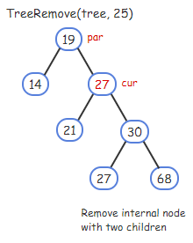

Internal Node Removal: Step 2

Slide 25
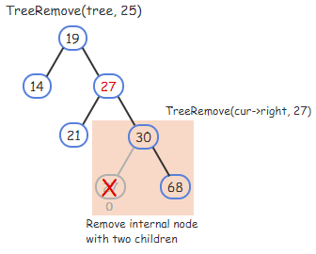
Internal Node Removal: Step 3

Slide 26
BST Inorder Traversal
A tree traversal algorithm visits all nodes in the tree once and performs an operation on each node
An inorder traversal visits all nodes in a BST from smallest to largest
Useful for printing the tree’s nodes in sorted order
Starting from the root, the algorithm recursively prints the left subtree, the current node, and the right subtree

Slide 27
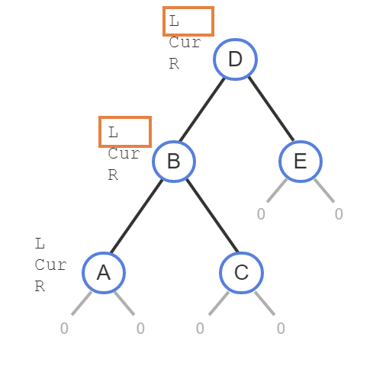
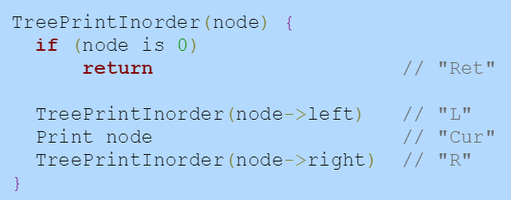
BST Inorder Traversal

Slide 28
Example Using Provided Java BST

Slide 29
Example Creating Your Own BST in Java
http://www.baeldung.com/java-binary-tree

Slide 30
Quiz this Week
Trees

Slide 31
Assignment This Week
BST

Slide 32
Zybooks
Binary Trees and BST
Sections 4.1 – 4.7

